Slide 1

An IoT based Smart Helmet System Measuring Blood Alcohol Concentration(BAC) for Accident Detection and Notification
Presented By: Supervisor: External:
MAHFUJUR RAHMAN
Department of Computer Science
Faculty of Science & Information Technology
American International University-
Bangladesh
SHARFUDDIN MAHMOOD
Department of Computer Science
Faculty of Science & Information Technology
American International University-
Bangladesh
ID | Name
19-40418-1 | ABIR IBRAHIM BIN MONIR
19-39383-1 | MD SALEM AHMED
19-40018-1 | KAJOL
19-40450-1 | ABDUR RAHAMAN TUTUL

Slide 2
Contents
Introduction
Problem Statement
Research Objective
Contribution of the Study
Related Work
Background Study
Literature Review
Proposed Method & Components
Datasets & experimental results
Results
Discussions
Conclusion

Slide 3
Introduction
The Internet of Things (IoT)
An IoT-based project that aims to prevent accidents caused by drunk drivers on motorbikes
The proposed system utilizes an Arduino microcontroller, alcohol sensor, GPS module, force and vibration sensor, GSM module, and LCD display.

Slide 4
Problem Statement
Highest rates of road traffic accidents
Identify drunk driving
Identify Driver Patient
Identify Accident and Accident sport
Automatic call and massage in Emergency Contact

Slide 5
Research Objective
People safety (In 2018, more than 5,000 people died)
Safe Rode
Prevent Accident
First treatment
No drunk driving

Slide 6
Contribution of the Study
The proposed system utilizes an Arduino Uno Board, alcohol sensor, GPS module, force and vibration sensor, GSM module, and LCD display.
A system that can monitor and control the operation of a motorbike, ensuring that it is not being driven by a drunk driver.
The Arduino microcontroller acts as the brain of the system, receiving input from the various sensors and modules and processing it to make decisions
GPS module that can detect and respond to location.
Accident is detected based on data from the force and vibration sensor

Slide 7
Related Work
Background Study
This IoT Device provides a user friendly ,secured environment, easy to use with a decentralized, safety, verifiable, programmable, immutable, divisible, and faster technology.
Prevent the accident issue
1
0.8
0.6
Accuracy
0.4
Precision
0.2
Alcohol
Accident
Accident Call
Detection
Detection

Slide 8
Related Work
The goal of this paper ”Alcohol detection using smart helmet system” is to design and implement a smart helmet system for detecting alcohol consumption by drivers.[1]
Used to continuously monitor the alcohol level in the wearer's breath
Consists of a microcontroller, a breath alcohol sensor, and a wireless communication module
Used a hardware and software framework for to facilitate communication between the device and the central server

Slide 9
Related Work (cont’d)
The goal of this thesis paper “An IOT Based Smart System for Accident Prevention and Detection” is to design and develop a system that improves safety for motorcycle riders.[2]
Utilizes various sensors, including vibration sensors, an RFID reader, a GPS module, a GSM module, ultrasonic sensors, an accelerometer, and an alcohol sensor, as well as vehicle-to-vehicle communication and a mobile edge computing system
Aims to prevent accidents by detecting dangerous conditions

Slide 10
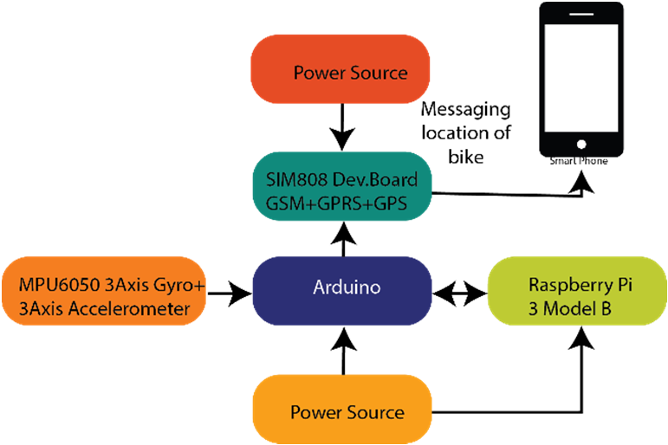
Related Work (cont’d)
The "Design and Implementation of a Smart Bike Accident Detection System" is a research paper that describes the design and implementation of a system for detecting accidents involving bicycles.[3]
The authors of this thesis paper” Accident Detection and Reporting System using Internet of Things” aim to design and implement an accident detection and reporting system using Internet of Things (IoT) technologies.[4]
Improve the speed and efficiency of accident reporting
Response in order to reduce fatalities and injuries caused by traffic accidents

Slide 11
Related Work (cont’d)
The proposed thesis paper “Smart Helmet with Cloud GPS GSM Technology for Accident and Alcohol Detection” presents a design for a smart helmet system that is intended to improve the safety of motorcyclists.[5]
Designed to detect accidents using MEMS sensors( detect changes in pressure applied to the helmet, and are able to identify when an accident has occurred)
An alcohol sensor, known as an MQ3 sensor

Slide 12
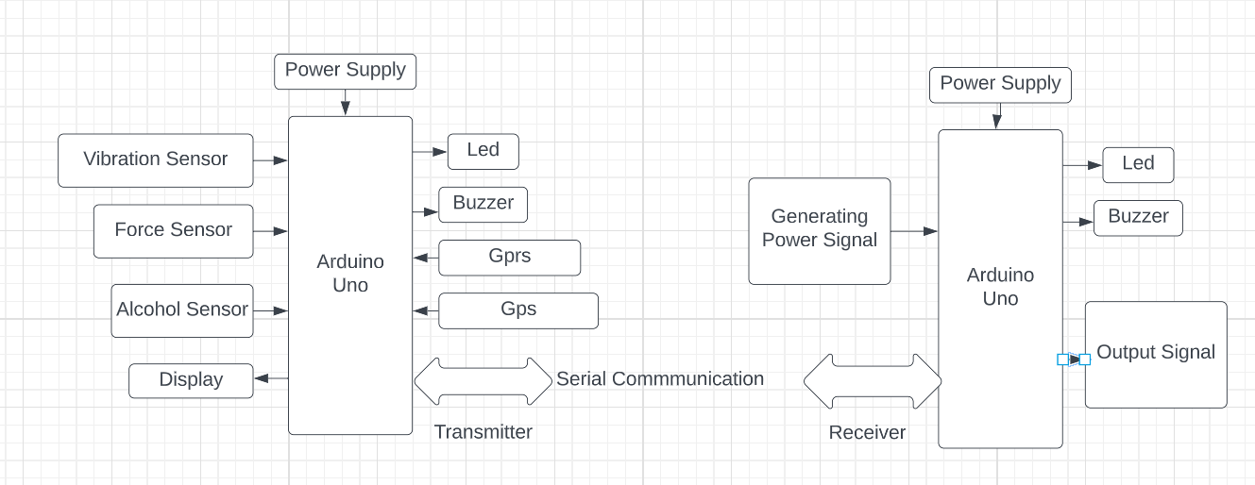
Proposed Method & Components
The Proposed system is divided into mainly two modules
the transmitter module and the receiver module.

Slide 13
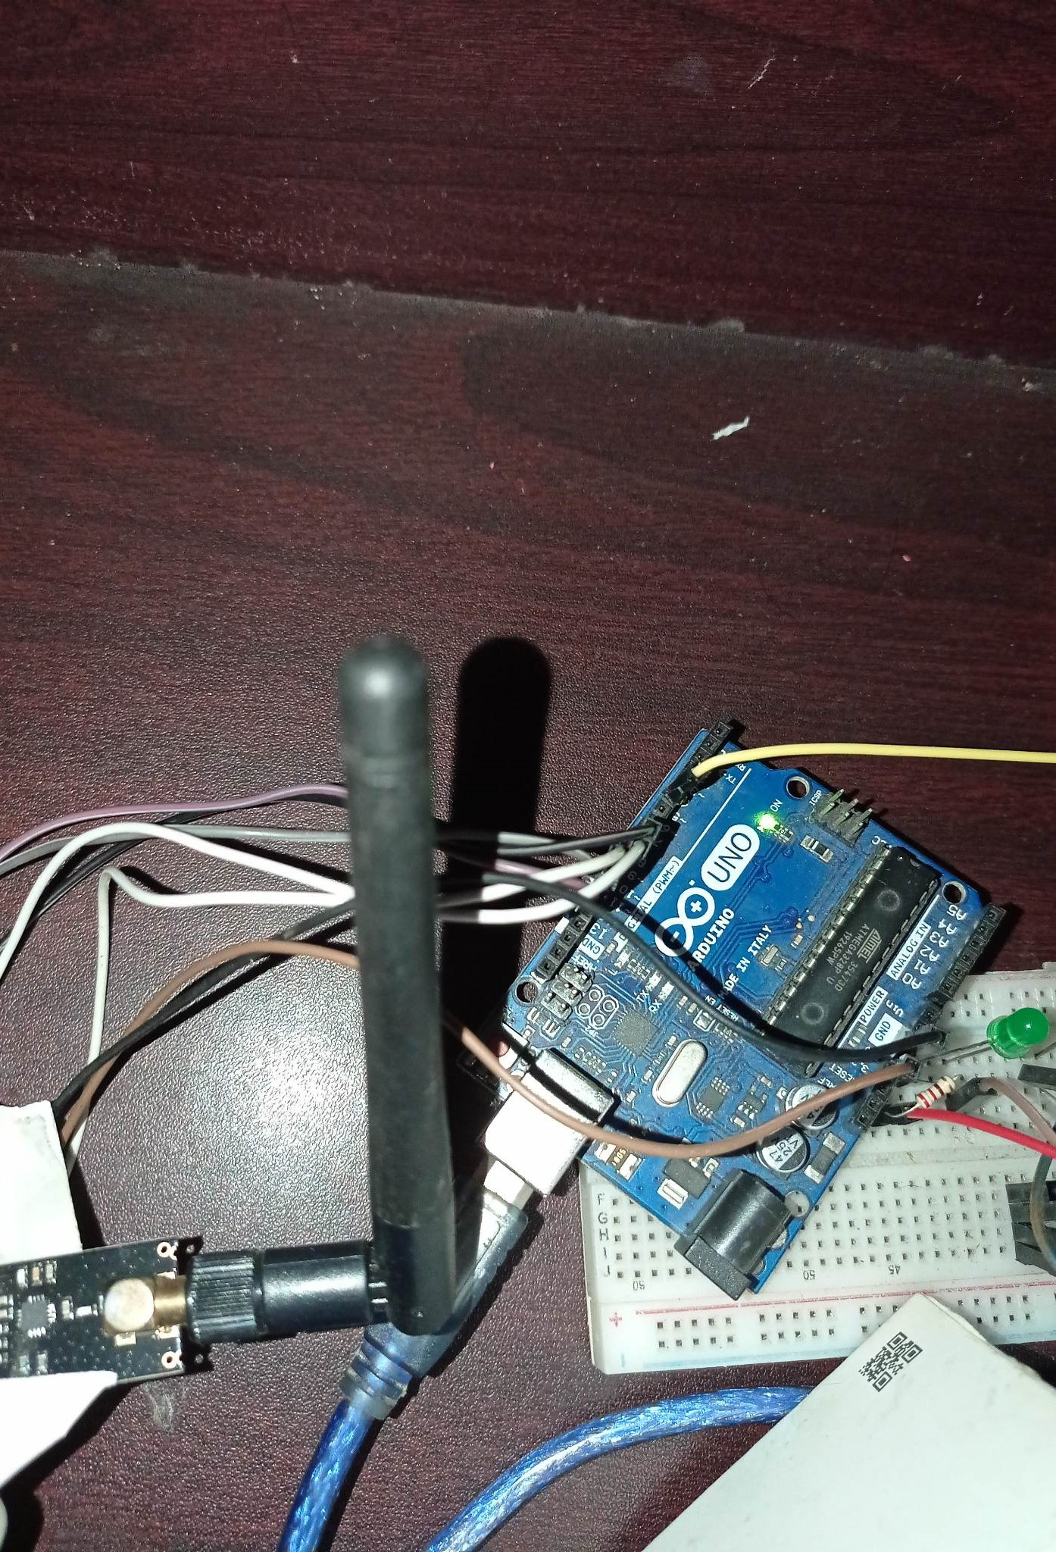
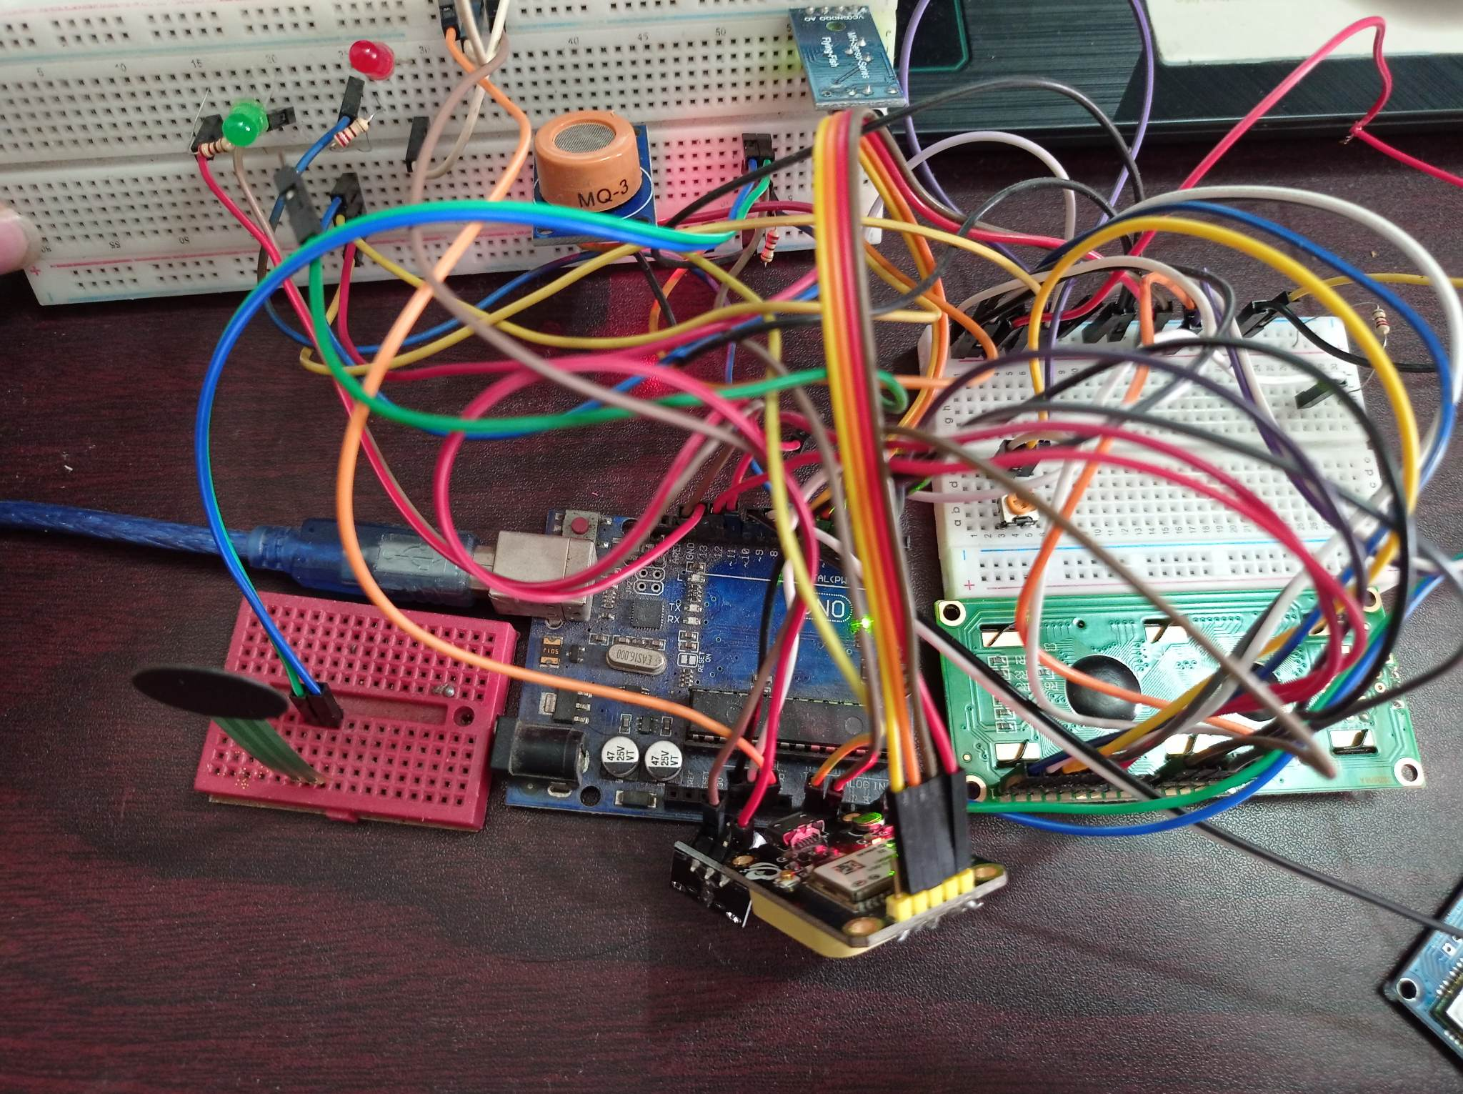
Proposed Method & Components
The Proposed system is divided into mainly two modules
the transmitter module and the receiver module.

Slide 14
Proposed Method & Components
Components
MQ-3 Alcohol Sensor
Active Speaker Buzzer
Arduino Uno R3
Vibration Sensor Module
NEO-6M GPS Module
Force Sensor
nRF24L01+ Wireless Module
LCD Display
GSM SIM 900 A
Led

Slide 15
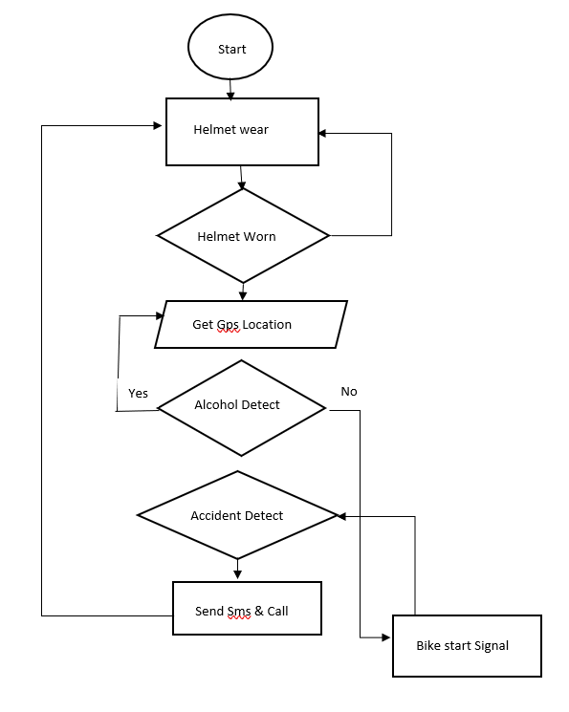
Proposed Method & Components (cont’d)
Check Helmet Wear
Access Current Location
Check Alcohol Under Range
Check Force Occured
Send Message & Call
Transmitter

Slide 16
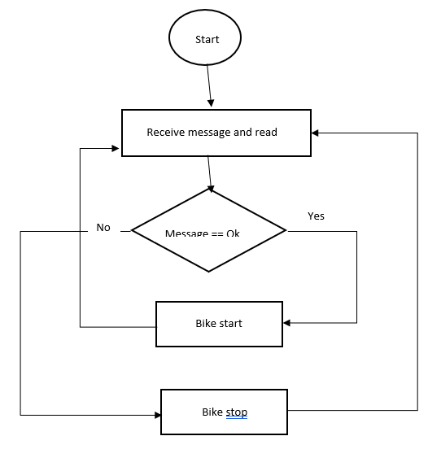
Proposed Method & Components (cont’d)
Receiver Read Message
Signal pass bike
Bike Start
Receiver

Slide 17
Proposed Method & Components (cont’d)
FUNCTIONALITIES
The alcohol sensor tells whether the rider was in normal state or drunken state.
The Force sensor detects the accidents based on the pressure applied on the helmet.
Transmitter pass signal when alcohol under range
The system should be able to detect the accident spot based on latitude on longitude values
The system should be able to send the text message and call to the emergency canter and family members

Slide 18
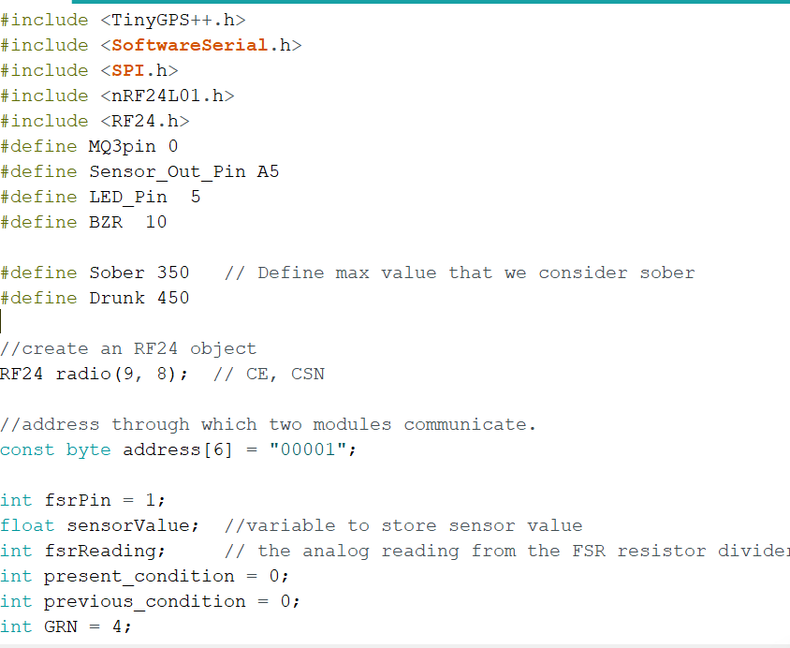
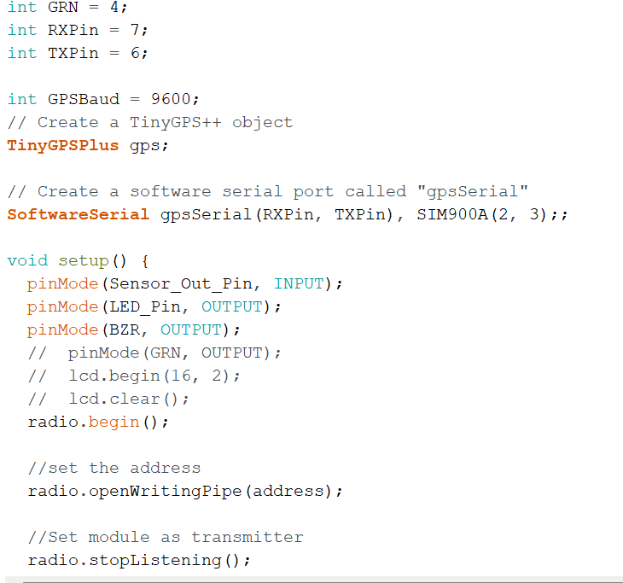
Implementation Details (cont’d)
Smart Helmet System
Initialize All Global Variable and Pin configuration with Arduino Uno Board

Slide 19
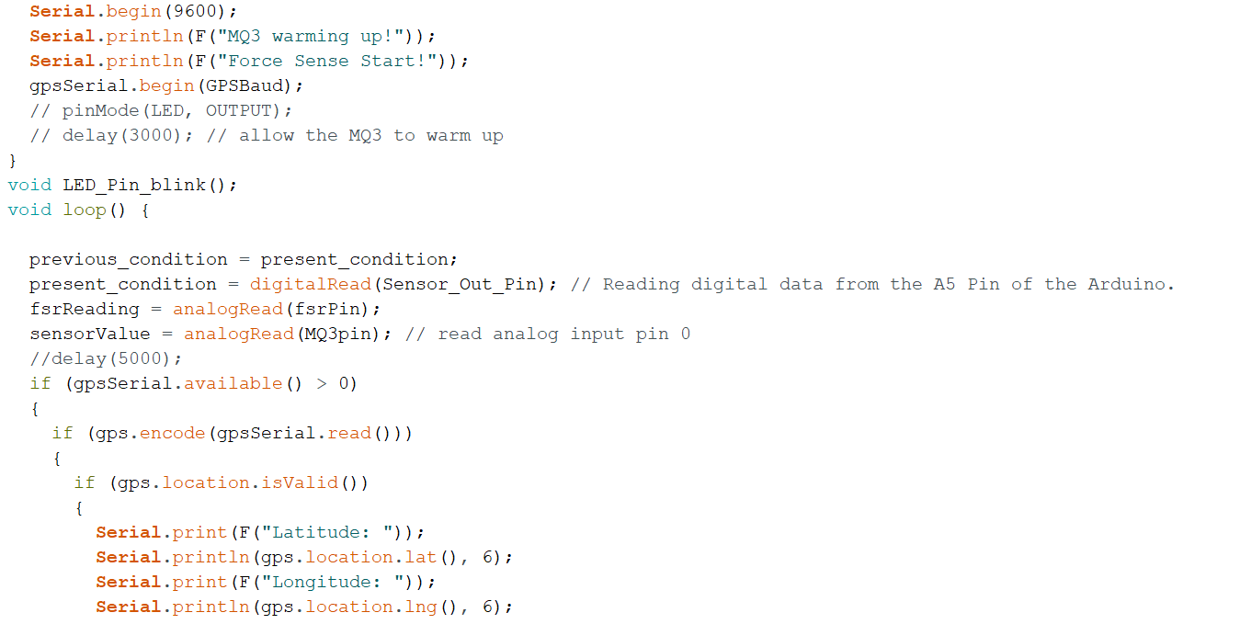
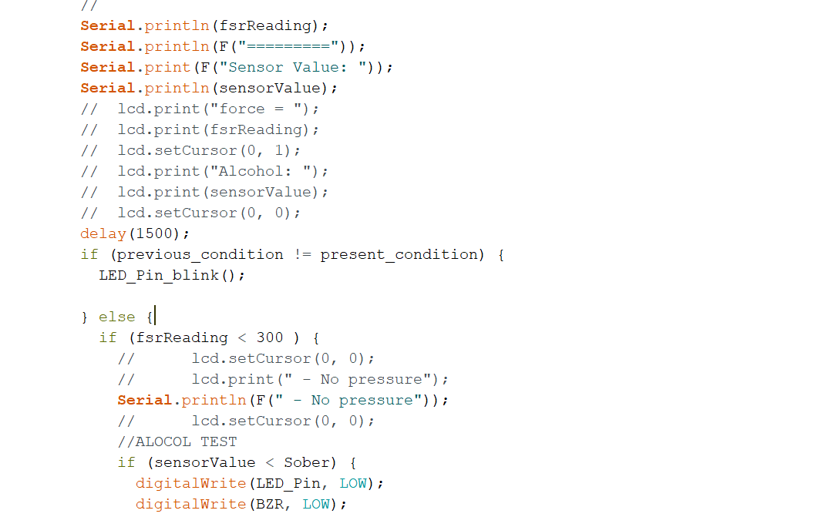
Implementation Details (cont’d)
Smart Helmet System
Trac Current Location And read alcohol sensor data and Read Force Sensor Data

Slide 20
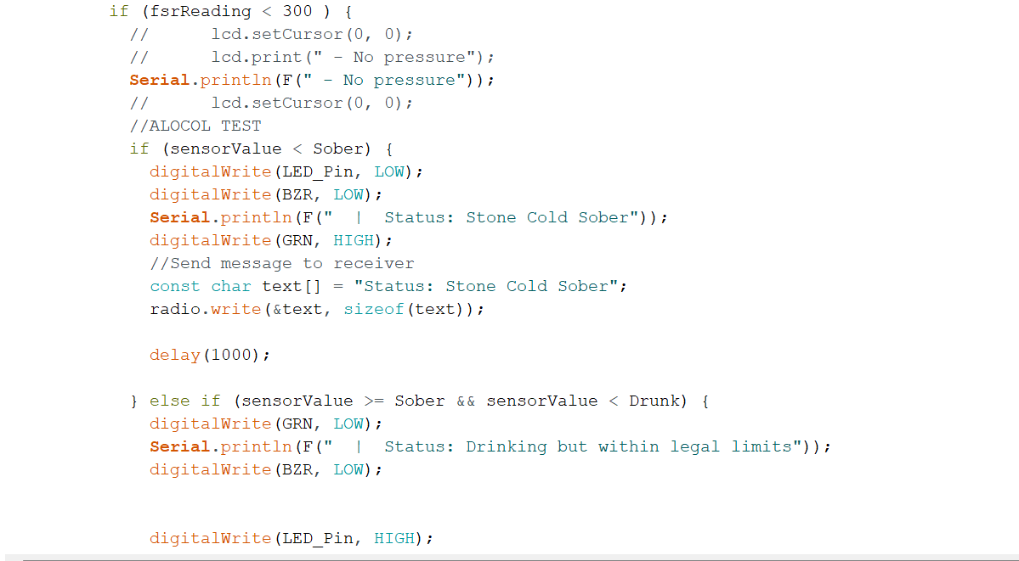
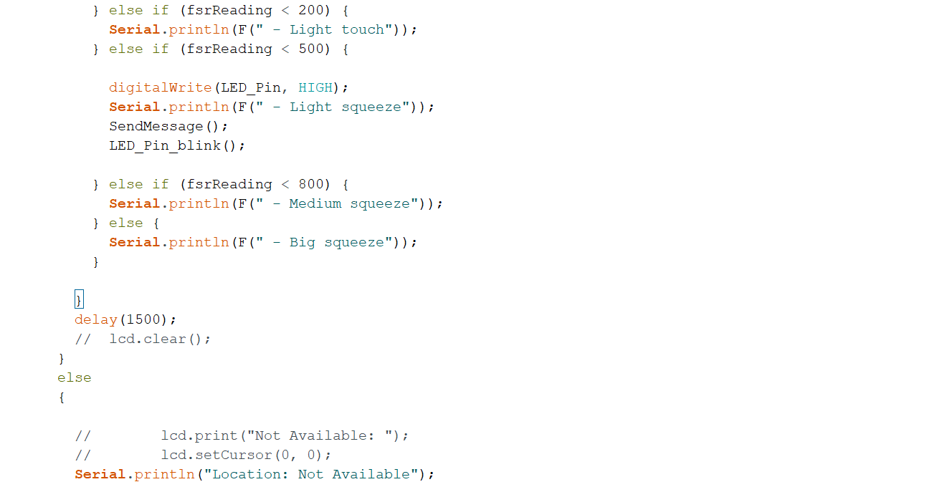
Implementation Details (cont’d)
Smart Helmet System

Slide 21
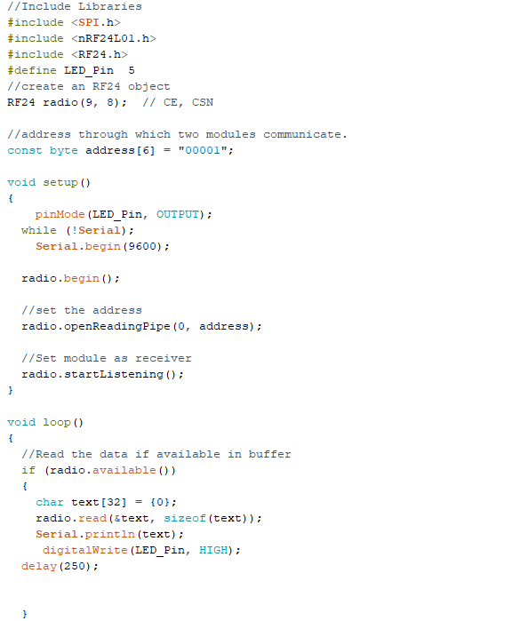
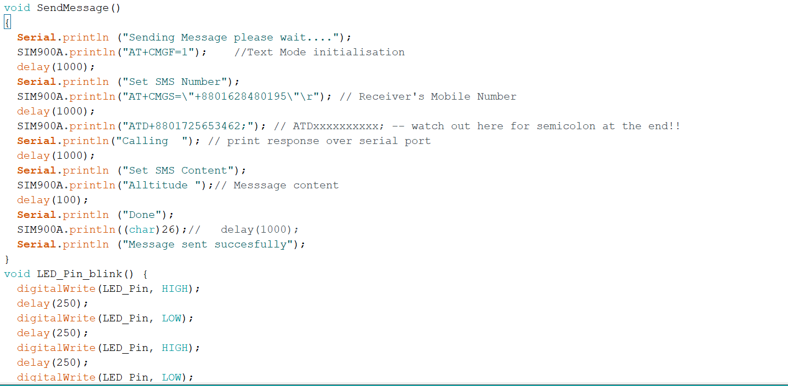
Implementation Details (cont’d)
Smart Helmet System
If accident occurred send sms and call and Receive signal data and check that bike starts or not

Slide 22
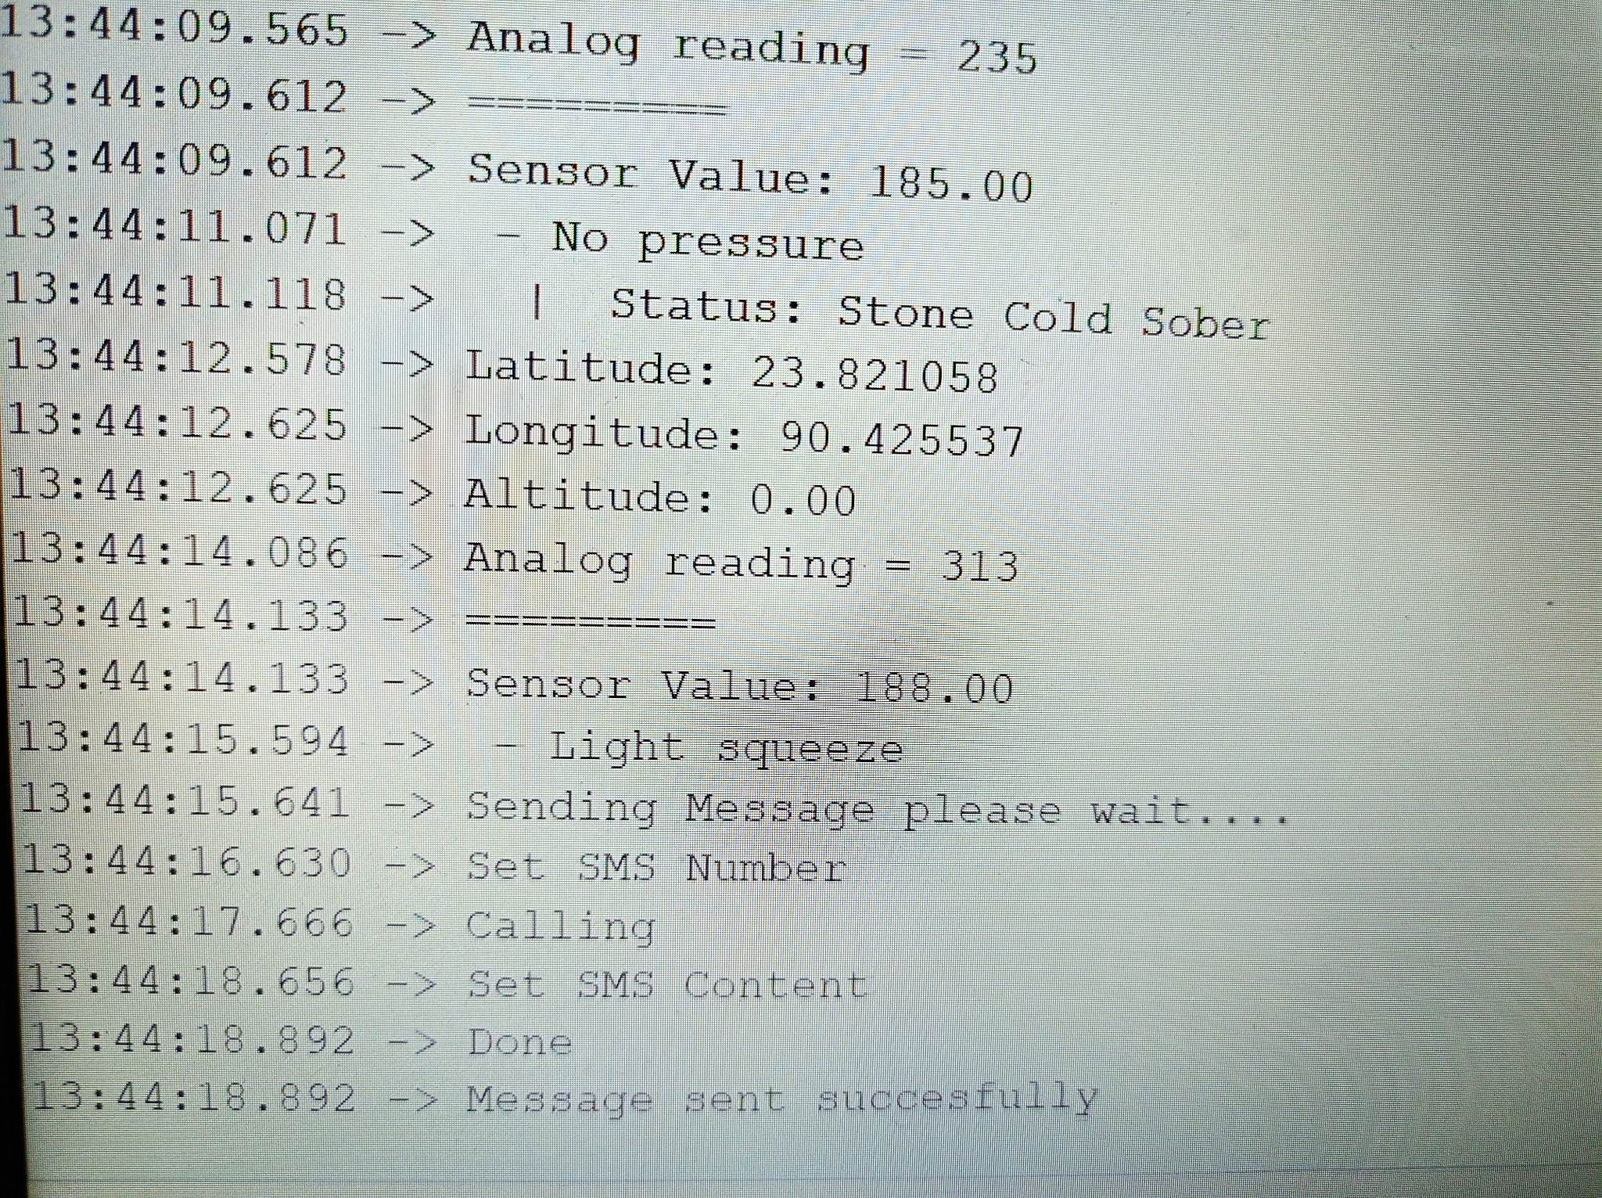
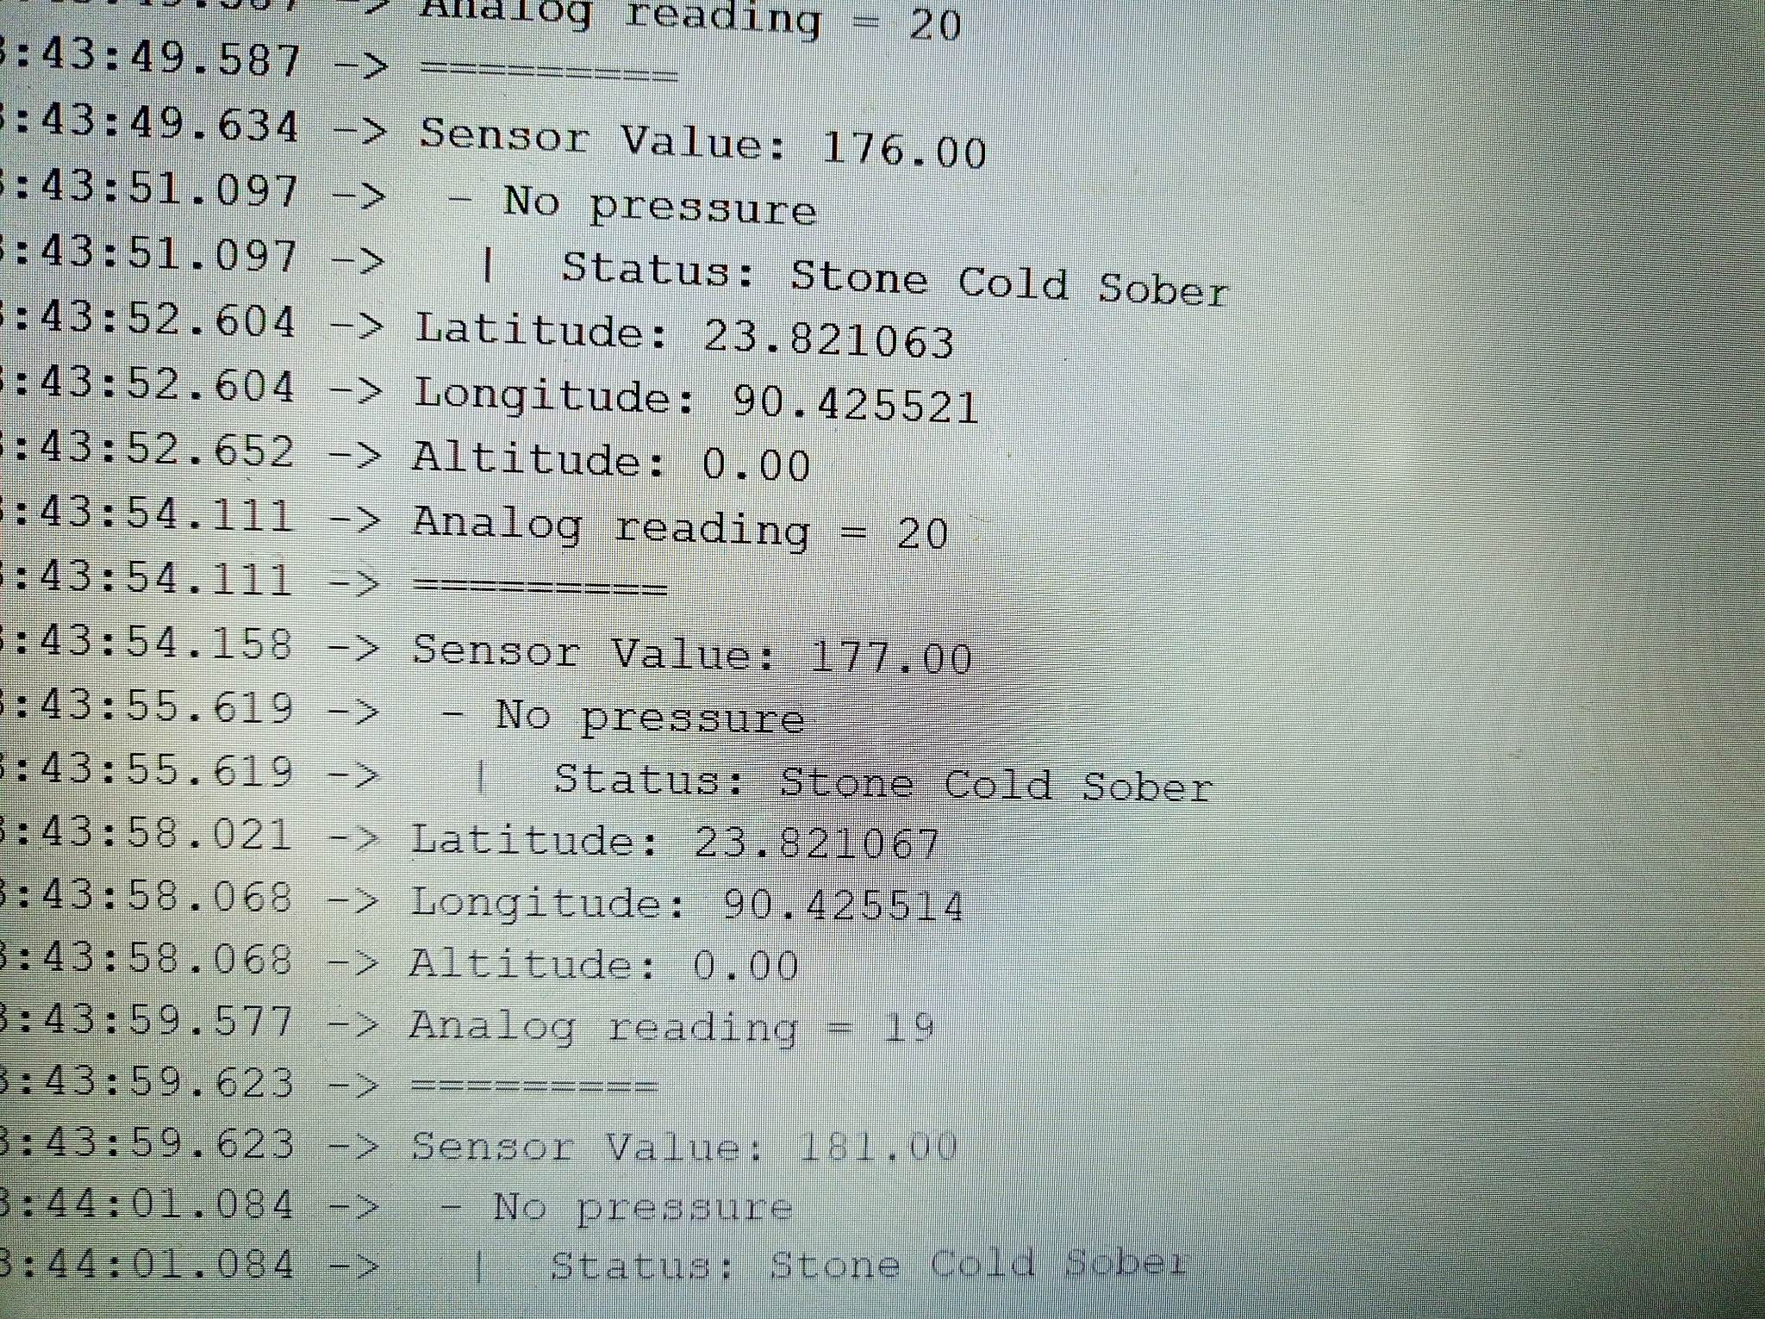
Results

Slide 23
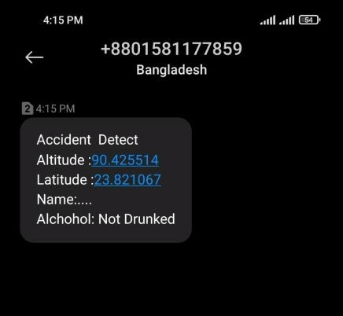
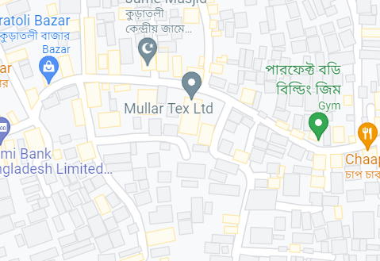
Results (cont’d)
The detected location will be in the form of latitudes and longitude values. Further this location will be sent to the concerned persons.

Slide 24
Results (cont’d)
ACCIDENT DETECTION TEST RESULTS:
SEND SMS AND CALL TEST RESULTS:
Force | Sensor Value | Expected Result | Reported Result
Force | 200 | False | False (10 cases)
Force | 500 | True | True (9of 10 cases)
Force | 800 | True | True (10 of 10 cases)
Force | Sensor Value | Expected Result | Reported Result
Force | 200 | False | False (10 cases)
Force | 500 | Send Sms Call | Send Sms Call (9of 10 cases)
Force | 800 | Send Sms Call | Send Sms Call (10 of 10 cases)

Slide 25
Results (cont’d)
ALCOHOL DETECTION TEST RESULTS:
Comparison of Parameters between All Functionalities:
Alcohol | Volume Consumed | Expected Result | Reported Result
Regular Alcohol | 200ml | False | False (10 cases)
Regular Alcohol | 330ml | True | True (7 of 10 cases)
Regular Alcohol | 600 ml | True | True (9 of 10 cases)
Regular Alcohol | 1000 ml | True | True (10 of 10 cases
1.2
1.0
0.8
.
0.6
Accuracy
.
0.4
Precision
.
0.2
0
Alcohol
Accident
Accident Call
Detection
Detection

Slide 26
Discussions
we have used Force sensor to detect the accident based on threshold value and alcohol sensor .
MQ3 sensor detects weather the motorcyclist has consumed alcohol or not. These two sensors are connected to Arduino-Uno board.
Accident location is detected using GPS.
Radio Module Connected helmet and bike.
Continuous Data pass between bike and helmet

Slide 27
Conclusion
This thesis presents an IoT-based project that aims to prevent accidents caused by drunk drivers on motorbikes, with a focus on the situation in Bangladesh.
Developed an IoT-based system that utilizes an Arduino microcontroller, alcohol sensor, GPS module, force and vibration sensor, GSM module, and LCD display.
Can monitor and control the operation of a motorbike, ensuring that it is not being driven by a drunk driver.
GPS module that can detect and respond to accidents
Sending coordinates of the location to a selected phone number and calling for an ambulance

Slide 28
References
[1] S. Vijayan, V. T. Govind, M. Mathews, S. Surendran, and M. S. M. E., "Title of Paper," International Journal of Emerging Technology in Computer Science & Electronics, vol. 8, no. 1, pp. 1-10, Apr. 2014.
[2] S. Nanda, H. Joshi and S. Khairnar, "An IOT Based Smart System for Accident Prevention and Detection," 2018 Fourth International Conference on Computing Communication Control and Automation (ICCUBEA), 2018, pp. 1-6, doi: 10.1109/ICCUBEA.2018.8697663.
[3] Huang, C.-M., Chang, Y., & Jia, Y. (2022). A Mobile-Based Novice Accident Detection and Tracking System for Bicycle.
[4] M. Muthuvel, S. Nivetha, & K. Sirushti, (2018). Accident Detection and Reporting System using Internet of Things.
[5] Dhulavvagol, P.M., Shet, R., Nashipudi, P., Meti, A.S., Ganiger, R. (2018). Smart Helmet with Cloud GPS GSM Technology for Accident and Alcohol Detection. In: Nagabhushan, T., Aradhya, V.N.M., Jagadeesh, P., Shukla, S., M.L., C. (eds) Cognitive Computing and Information Processing. CCIP 2017. Communications in Computer and Information Science, vol 801. Springer, Singapore. https://doi.org/10.1007/978-981-10-9059-2_31

Slide 29
Thank You

